Slide 1
LESSON 7.3
Energy From Fuels

Slide 2
LESSON GOALS
I can deduce equations for complete and incomplete combustion reactions
I can evaluate the amount of carbon dioxide added to the atmosphere when different fuels burn
I can understand the link between carbon dioxide and the greenhouse effect
I can understand the difference between renewable and non-renewable energy sources
I can consider the advantages and disadvantages of biofuels
I can deduce half-equations for the electrode reactions in a fuel cell

Slide 3
NOTE: This lesson will NOT be included on the checkpoint for this LO
BUT
WILL appear on the midterm/January exam!

Slide 4
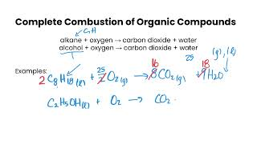
TASK 1: LEARN (ASPIRE TO DO)
Watch the Combustion Reactions video
Take some notes for yourself!

Slide 5
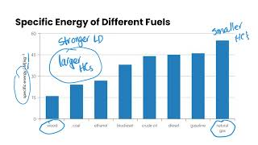
TASK 2: LEARN (ASPIRE TO DO)
Watch the Fossil Fuels & Biofuels video
Complete the appropriate section of the guided note

Slide 6
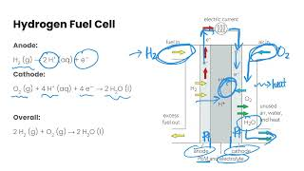
TASK 3: LEARN (ASPIRE TO DO)
Watch the Fuel Cells video
Complete the appropriate section of the guided note

Slide 7
TASK 4: PRACTICE (ASPIRE TO DO)
Individually or with a partner:
Complete the practice questions on pg. 441 in your textbook

Slide 8
TASK 5: READ (ASPIRE TO DO)
Read the section on Energy from Fuels in your textbook (pg. 424 - 440)

Slide 9
TASK 6: MASTERY CHECK
(ASPIRE TO DO)
Complete the Energy From Fuels mastery check (posted in Brightspace!)

